Slide 1


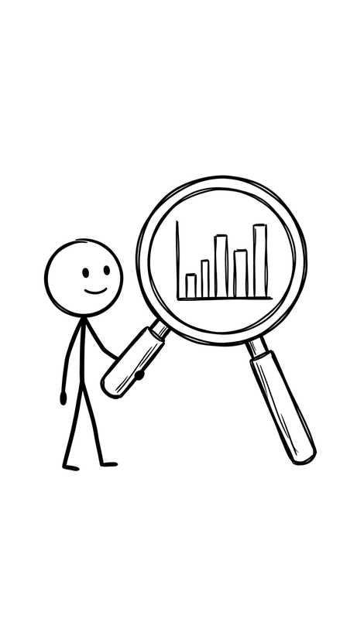
Introduction to Prediction Models in Health Research
A worked example: predicting dementia risk using machine learning
Dr Desy Nuryunarsih
School of Medicine, University of St Andrews
INGAT-ID Study | Identifikasi Neurokognitif Gangguan Alzheimer/demensia Terpadu | Indonesia

Slide 2

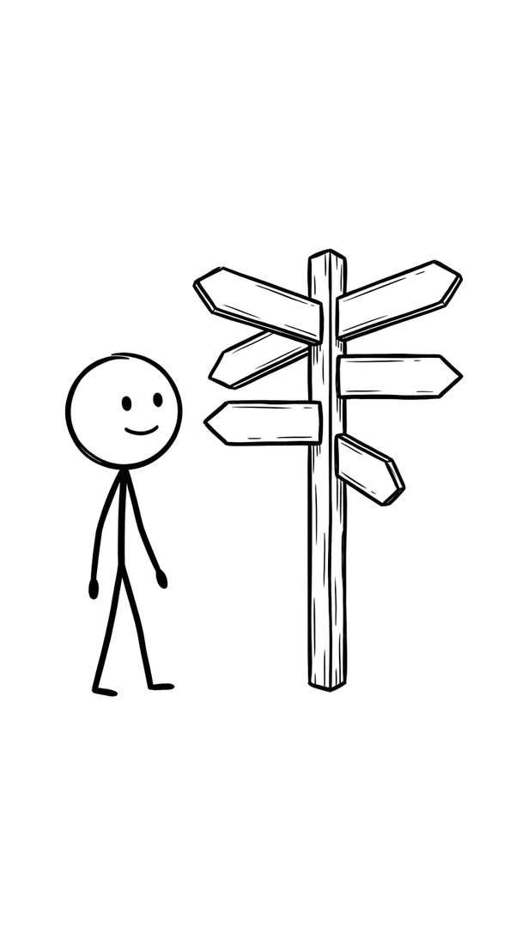
What We'll Cover Today
• Part 1: What is a prediction model, and why do we build them?
• Part 2: The basic steps of building one
• Part 3: Common types of models (statistical vs. machine learning)
• Part 4: How we know if a model is any good
• Part 5: Worked example : a dementia risk prediction study

Slide 3

What Is a Prediction Model?
• A tool that estimates the probability of an outcome, using known information about a person or case
• Example: predicting whether a patient will develop a disease, based on their age, symptoms, and test results
• Two ingredients: predictors (inputs / features) and an outcome (what we're trying to predict)
Goal: support decisions who to screen, who to treat earlier, who needs monitoring

Slide 4
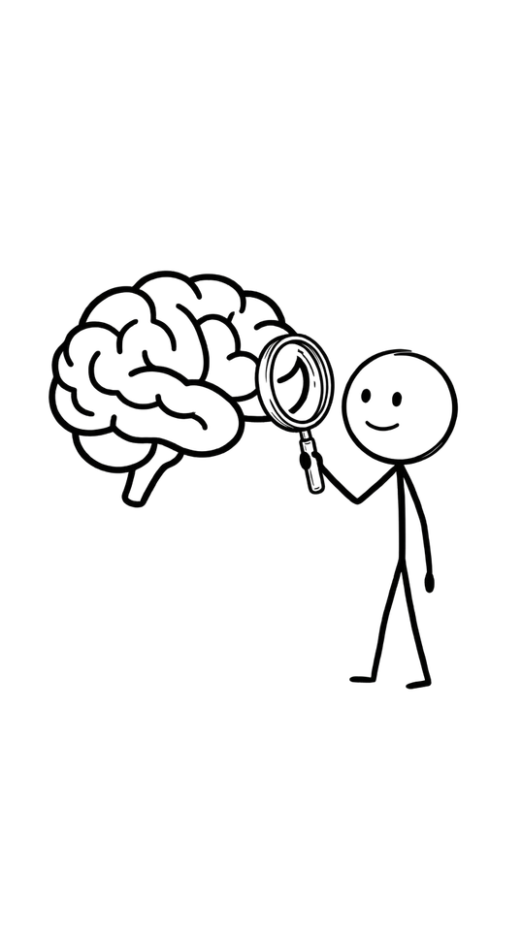
Why Do We Need Prediction Models in Health Research?
• Many diseases are easier to prevent or manage if caught early
• Clinicians can't mentally weigh 30–90 risk factors at once models can
• Successful examples: cardiovascular risk scores, stroke risk calculators
• Gap: very few validated models exist for some conditions in some populations (e.g., dementia in Indonesia, more on this later)

Slide 5
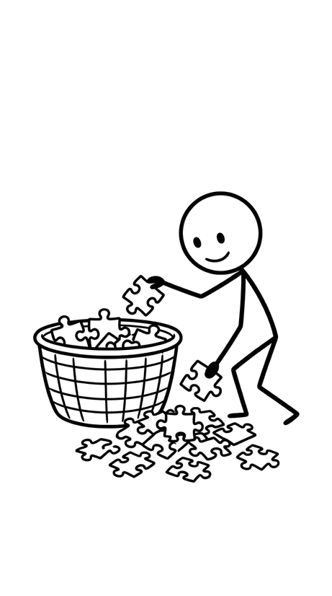
Two Key Terms: Predictors and Outcome
Predictors (also called: features, independent variables, risk factors) the information we measure about each person, e.g. age, blood pressure, lifestyle habit
Outcome (also called: target, dependent variable, label) what we are trying to predict, e.g. "will this person develop the condition? Yes/No"
A prediction model learns the relationship between predictors and outcome from data

Slide 6
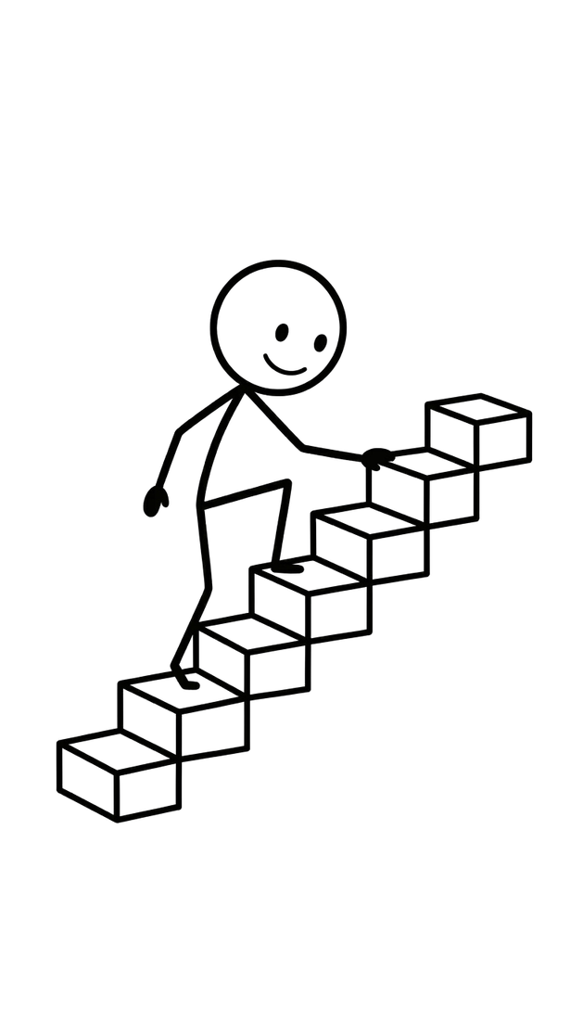
The Basic Steps of Building a Prediction Model
1. Define the outcome clearly (what exactly are we predicting, and how is it measured?)
2. Collect data (survey, medical records, lab results)
3. Clean the data (handle missing values, remove errors/outliers)
4. Split data into a training set and a test set
5. Fit ('train') the model on the training set
6. Test the model on data it hasn't seen before
7. Report how well it performed, and what factors mattered most

Slide 7
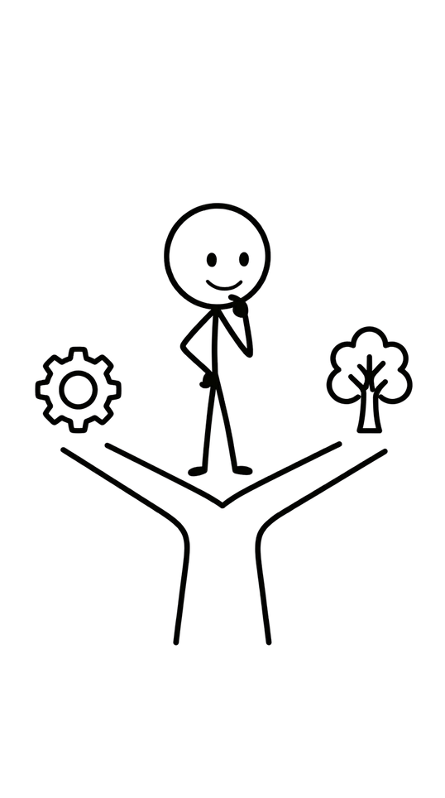
Statistical Models vs. Machine Learning Models
Statistical models (e.g. logistic regression): simpler, easier to interpret coefficients, long track record in medicine
Machine learning models (e.g. decision trees, random forests, XGBoost): can capture more complex patterns, often (not always) more accurate
Trade-off: some ML models are "black boxes" harder to explain why they made a prediction
Tree-based ML models are a nice middle ground: powerful, but still show a visual decision path

Slide 8
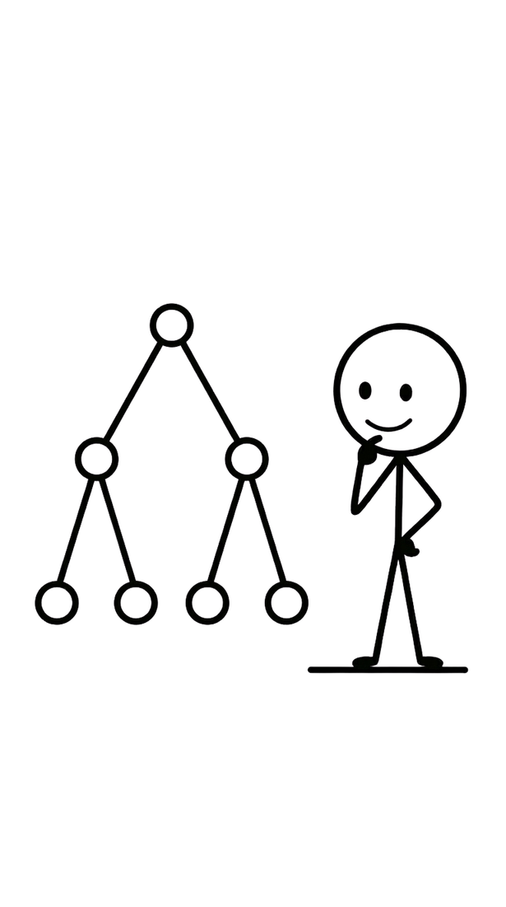
Decision Trees : the Simplest Tree-Based Model
Splits the data step-by-step using yes/no questions about the predictors
Example: "Does the patient take diuretics?" → "Are they over 60?" → prediction
Advantage: you can literally draw the decision pathway and show it to a clinician
Disadvantage: a single tree can be unstable small changes in data can produce a very different tree

Slide 9
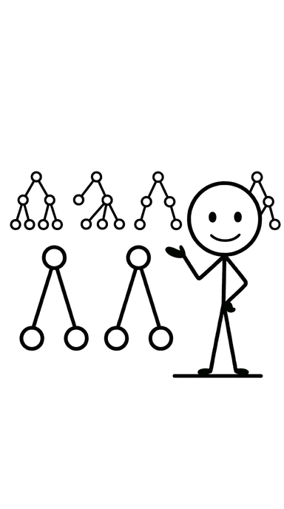
Random Forest and XG-Boost
Random Forest: builds many decision trees and averages their predictions more stable, usually more accurate than one tree
XGBoost: builds trees one after another, each one correcting the mistakes of the last often very accurate, but more complex to tune
Both are widely used in current health prediction research

Slide 10
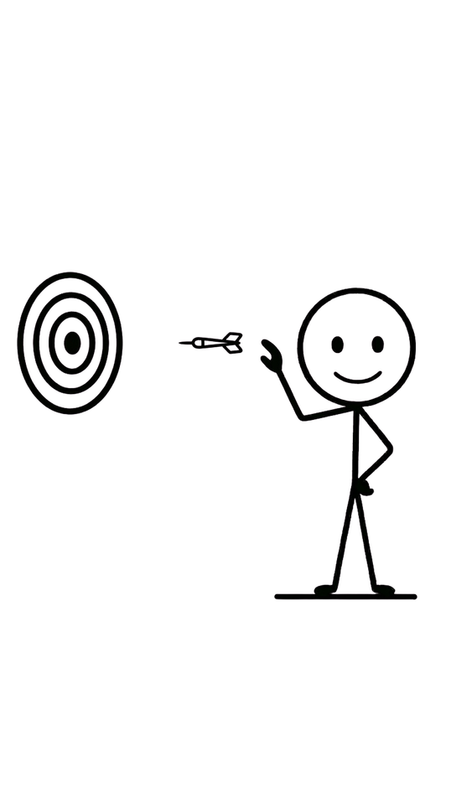
How Do We Know If a Model Is Good?
• Accuracy % of predictions that were correct overall
• Sensitivity % of true cases the model correctly identified
• Specificity % of true non-cases the model correctly identified
• AUC (Area Under the Curve) overall ability to distinguish cases from non-cases (0.5 = no better than chance, 1.0 = perfect)
• Calibration do the predicted risks match the real-world observed risks?

Slide 11
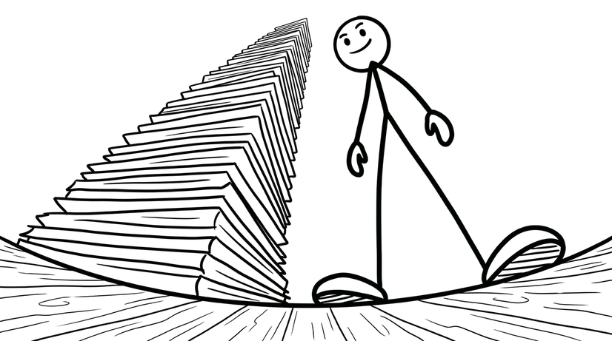
How Much Data Do We Need?
• More predictors generally require more participants to build a reliable model
• A common rule of thumb: at least 10 outcome "events" per predictor (events-per-parameter, EPP)
• More rigorous methods exist (e.g. Riley et al., 2020) that calculate exact sample size needed based on how many predictors you want and how good you expect the model to be
• Bigger sample size = more reliable, more trustworthy model
but also more time and cost to collect

Slide 12
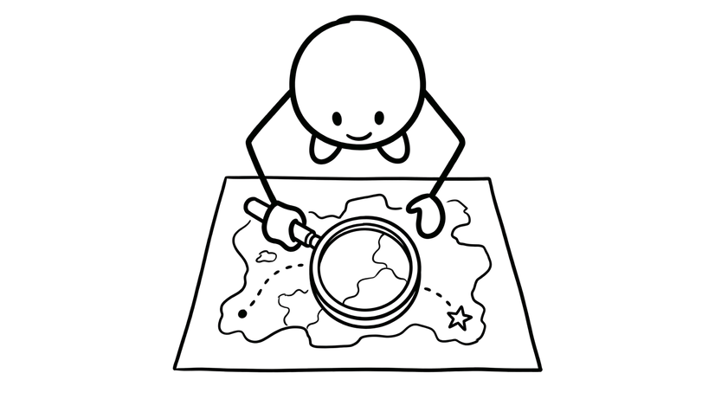
Case Study Intro (Dementia Risk in Indonesia)
• More predictors generally require more participants to
build a reliable model
• Bigger sample size = more reliable, more trustworthy model — but also more time and cost to collect

Slide 13
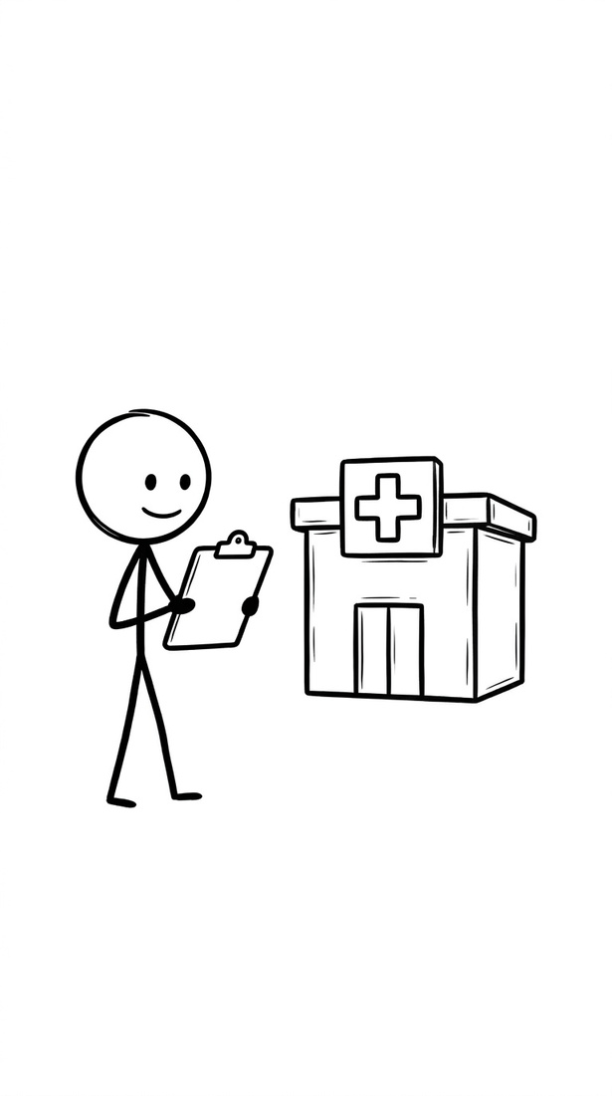
Case Study: Dementia Risk Prediction in Indonesia
• Motivation: dementia risk models exist mostly for high-income, Western populations
• A 2024 systematic review found almost no validated
dementia risk models developed specifically for low- and
middle-income countries, including Indonesia
• Our project: build and test a dementia risk model using data from two hospitals in Indonesia

Slide 14

Case Study: Study Design
• Design: cross-sectional (single visit per participant) practical for one funding cycle
• Setting: two hospitals in Indonesia
• Predictors: demographic, clinical, lifestyle,
socioeconomic, and family history information
(~20–30 variables)
• Outcome: current cognitive impairment status, measured using a validated screening tool (MMSE/MoCA)

Slide 15

Case Study: Three Connected Analyses from One Data Collection
• 1. Classification models (Decision Tree, Random Forest, XGBoost) predict who currently has cognitive impairment
• 2. Association rule mining (apriori algorithm) find which combinations of risk factors most often occur together
• 3. Decline-trajectory modelling using an informant-reported questionnaire (IQCODE) to estimate 10-year cognitive decline, without needing years of follow-up

Slide 16
Key Takeaways
• A prediction model turns known information (predictors) into an estimate of an unknown outcome
• Good models are tested on data they haven't seen, not just the data they were built on
• Tree-based ML models (Decision Tree, Random Forest, XGBoost) are widely used in current health research and balance accuracy with interpretability
• Sample size matters more predictors need more participants, and there are formal methods to calculate exactly how many
• Real research gaps (like dementia prediction in Indonesia) are genuine opportunities for new, useful research

Slide 17

Questions to Think About
• What outcome would you want to predict in your own area of interest?
• What predictors do you think would matter most, and why
• Would a simple model (logistic regression) or
a more complex one (Random Forest) suit your
question better?

Slide 18

References / Further Reading
• Riley, R. D., Ensor, J., Snell, K. I. E., et al. (2020). Calculating the sample size required for developing a clinical prediction model. BMJ, 368, m441.
• Brain, J., Kafadar, A. H., Errington, L., et al. (2024).
What's new in dementia risk prediction modelling?
An updated systematic review. Dementia and
Geriatric Cognitive Disorders Extra, 14, 49–74.
• Nuryunarsih, D., et al. (2025). Predicting systolic and diastolic blood pressure response using machine learning. Journal of Current Science and Technology, 15(4).

